Slide 1

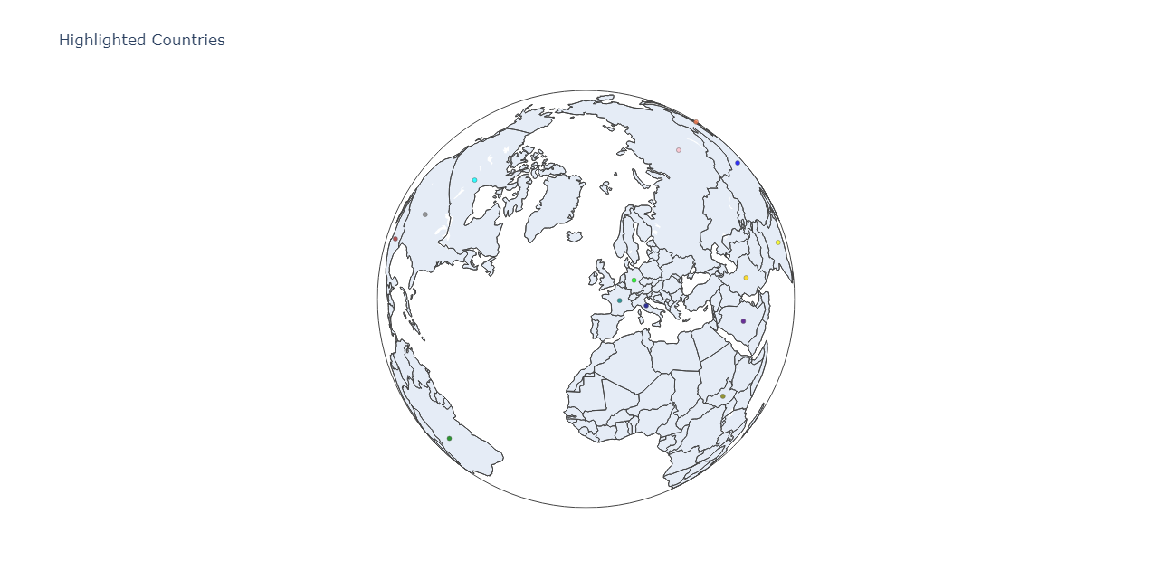
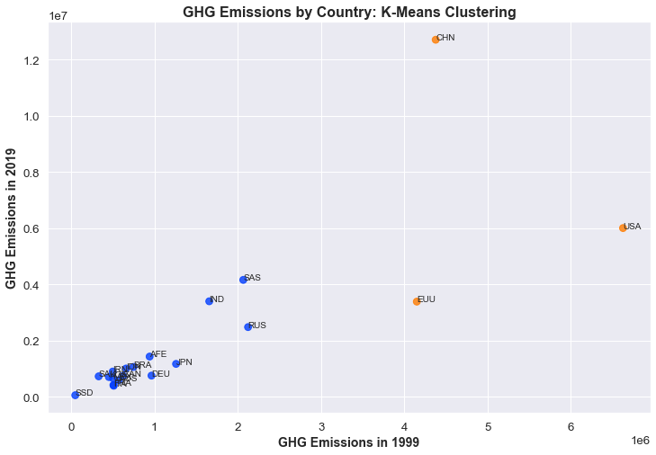
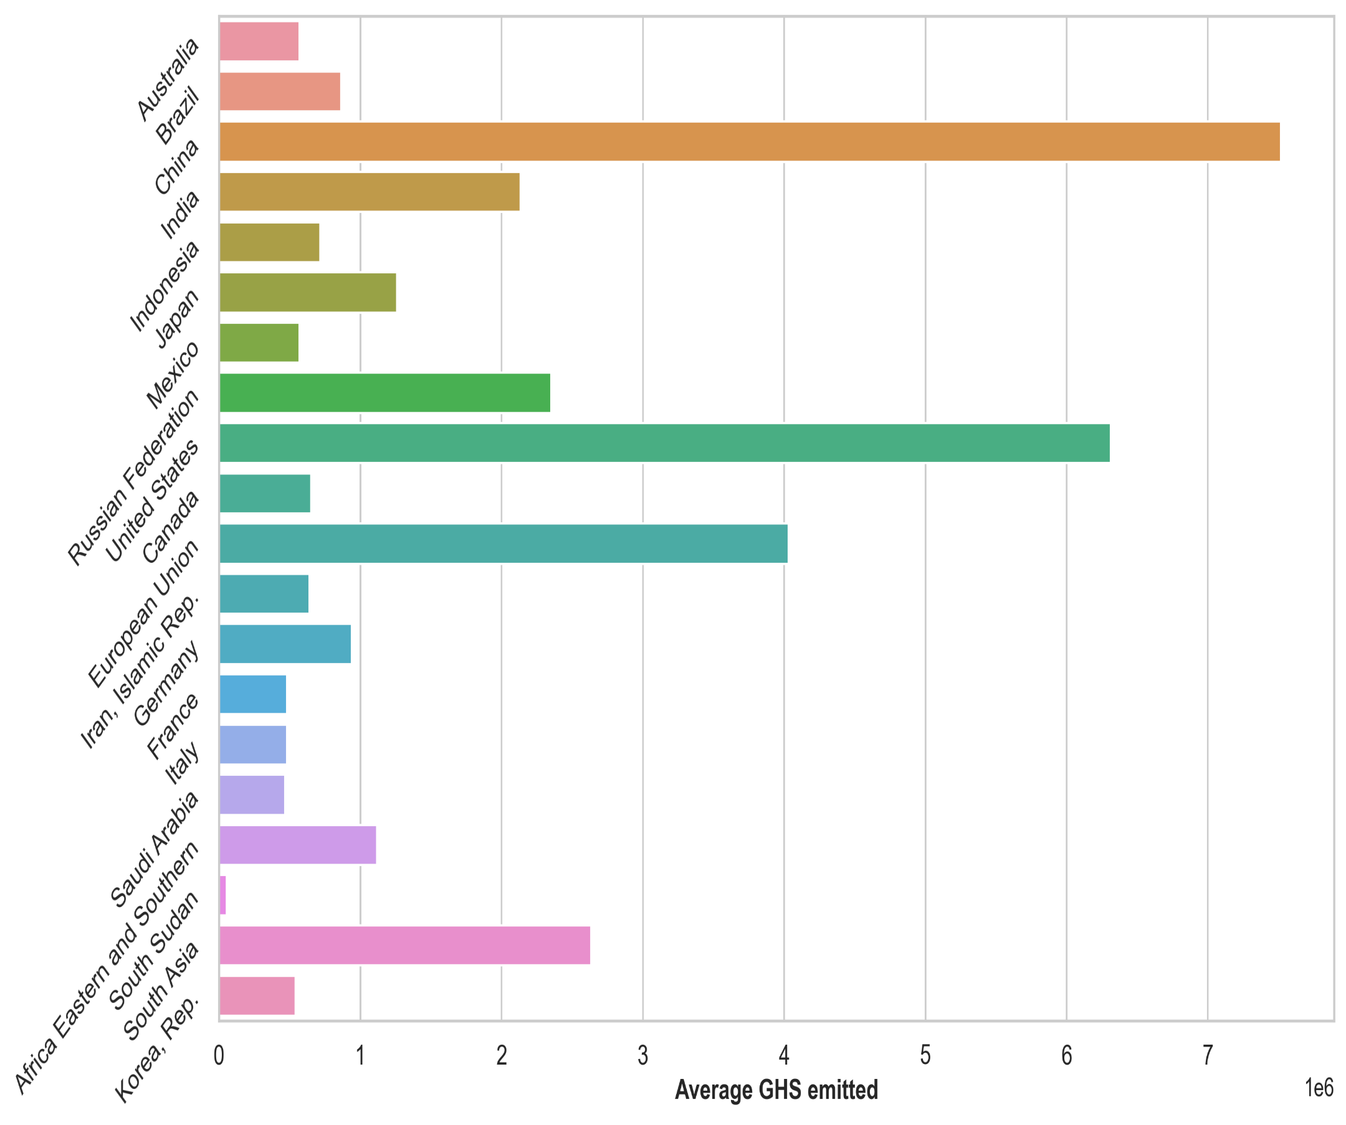
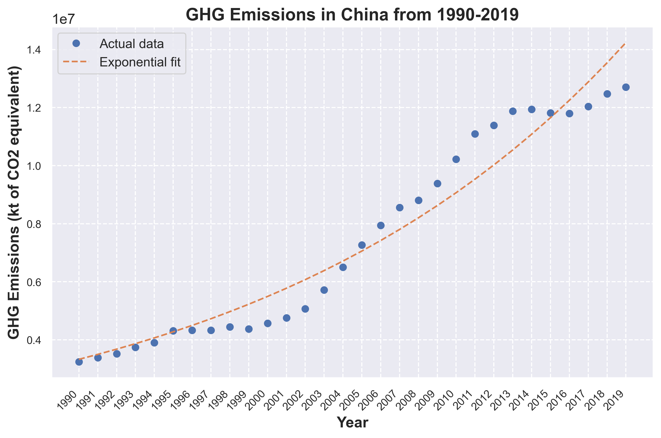
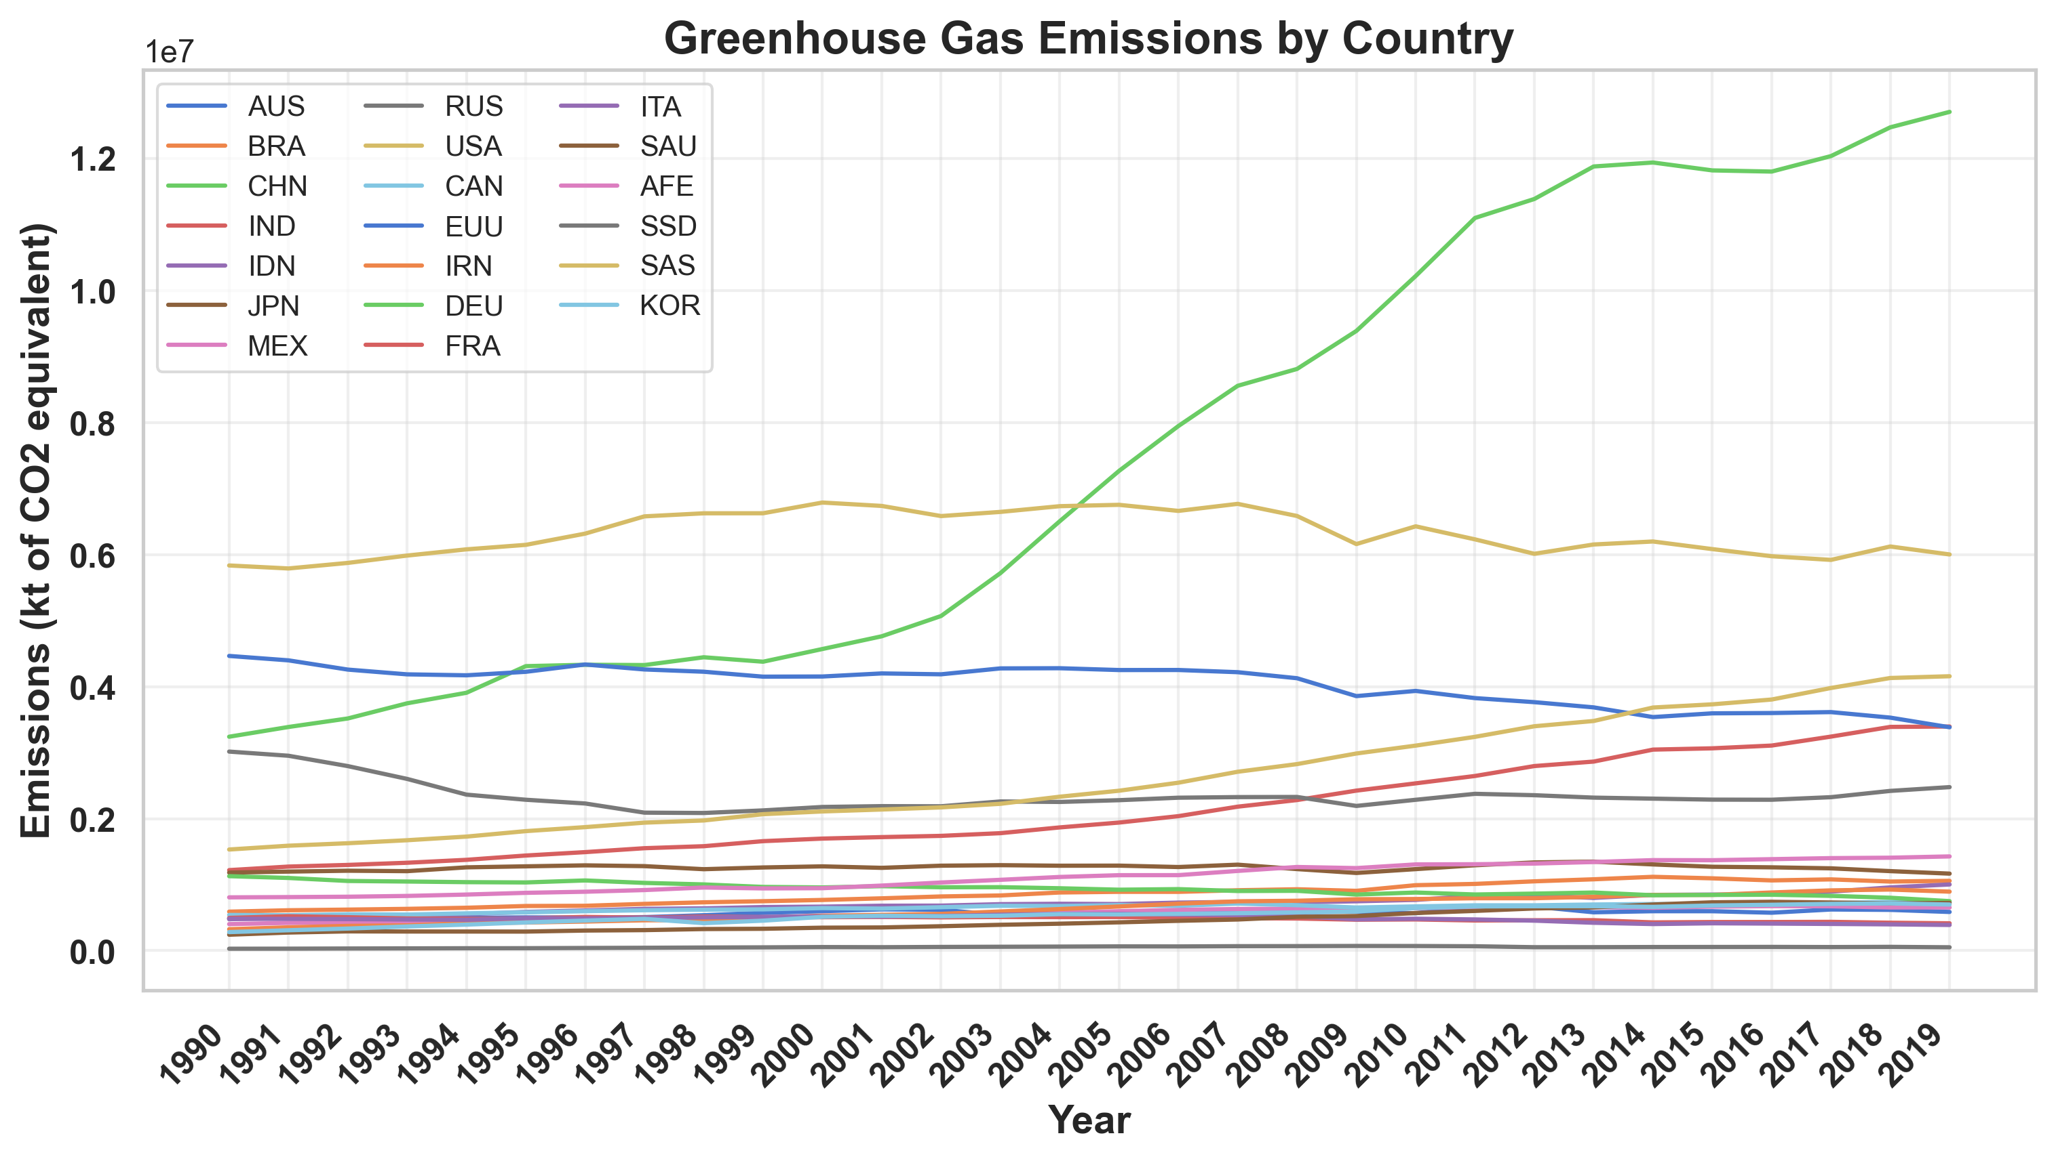
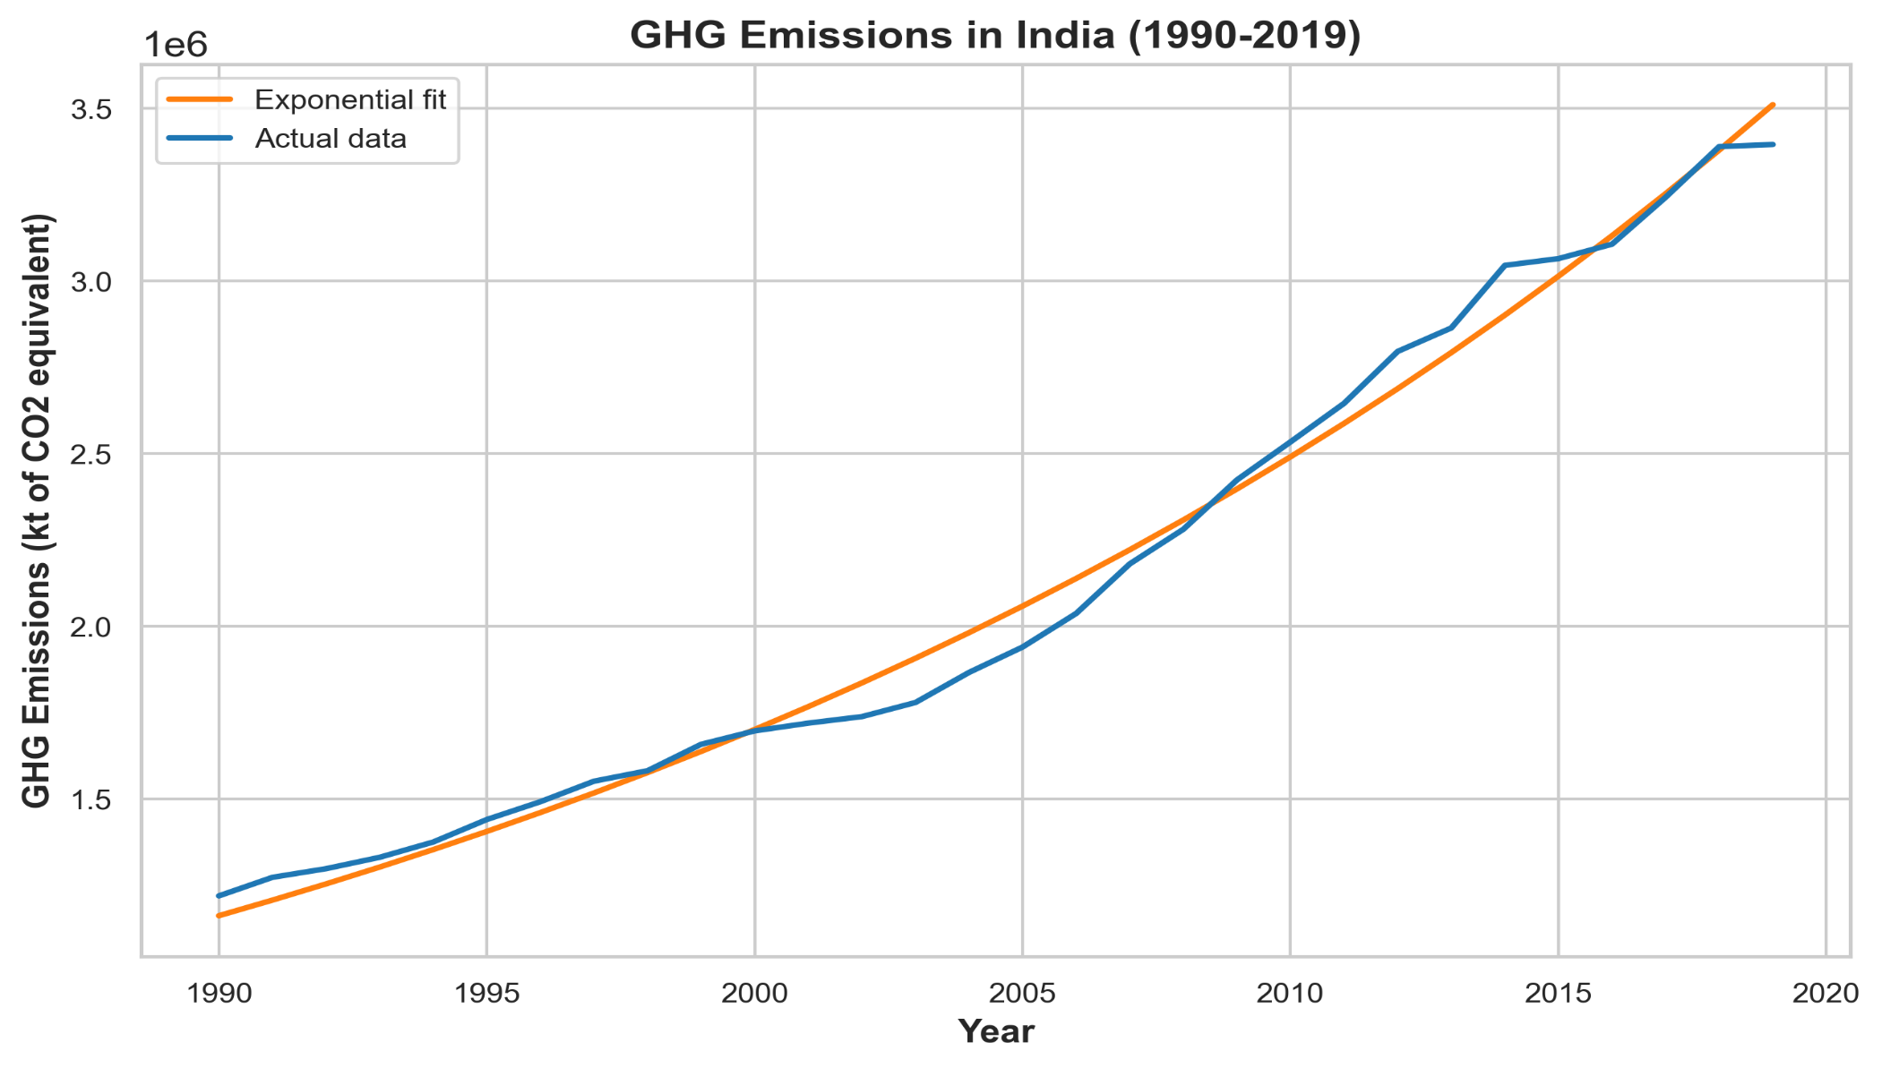
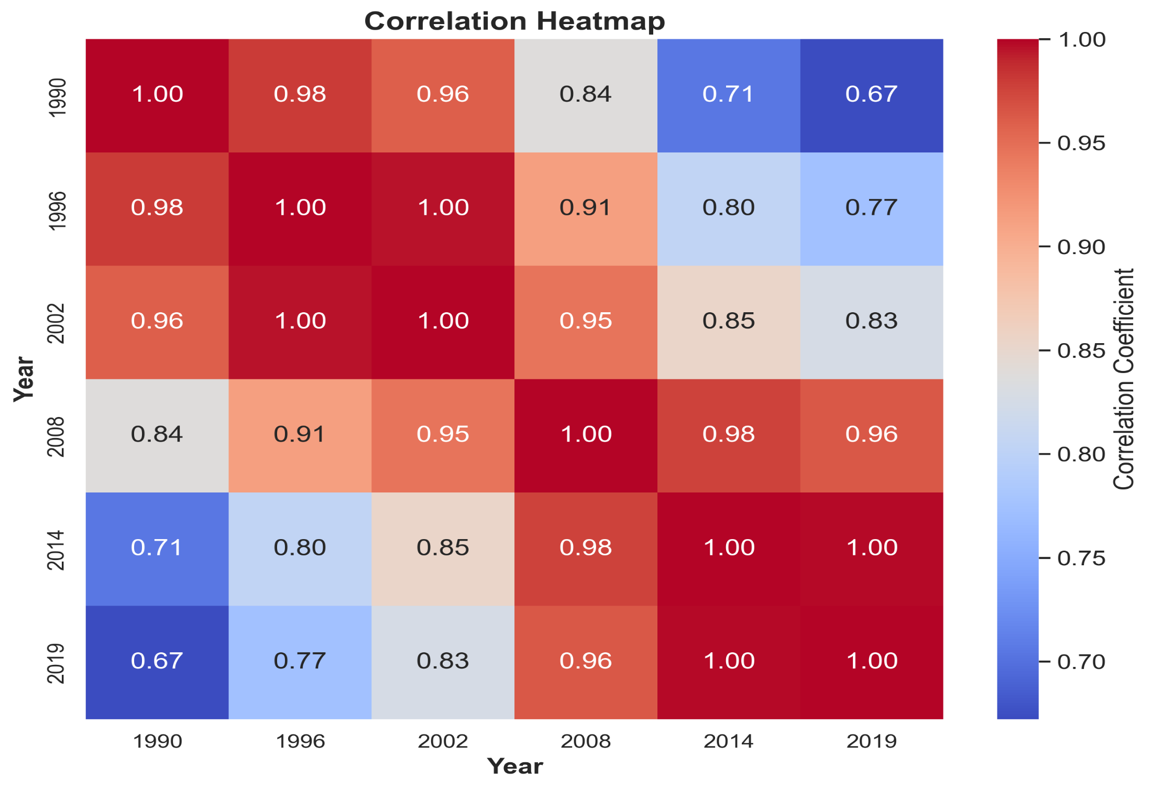
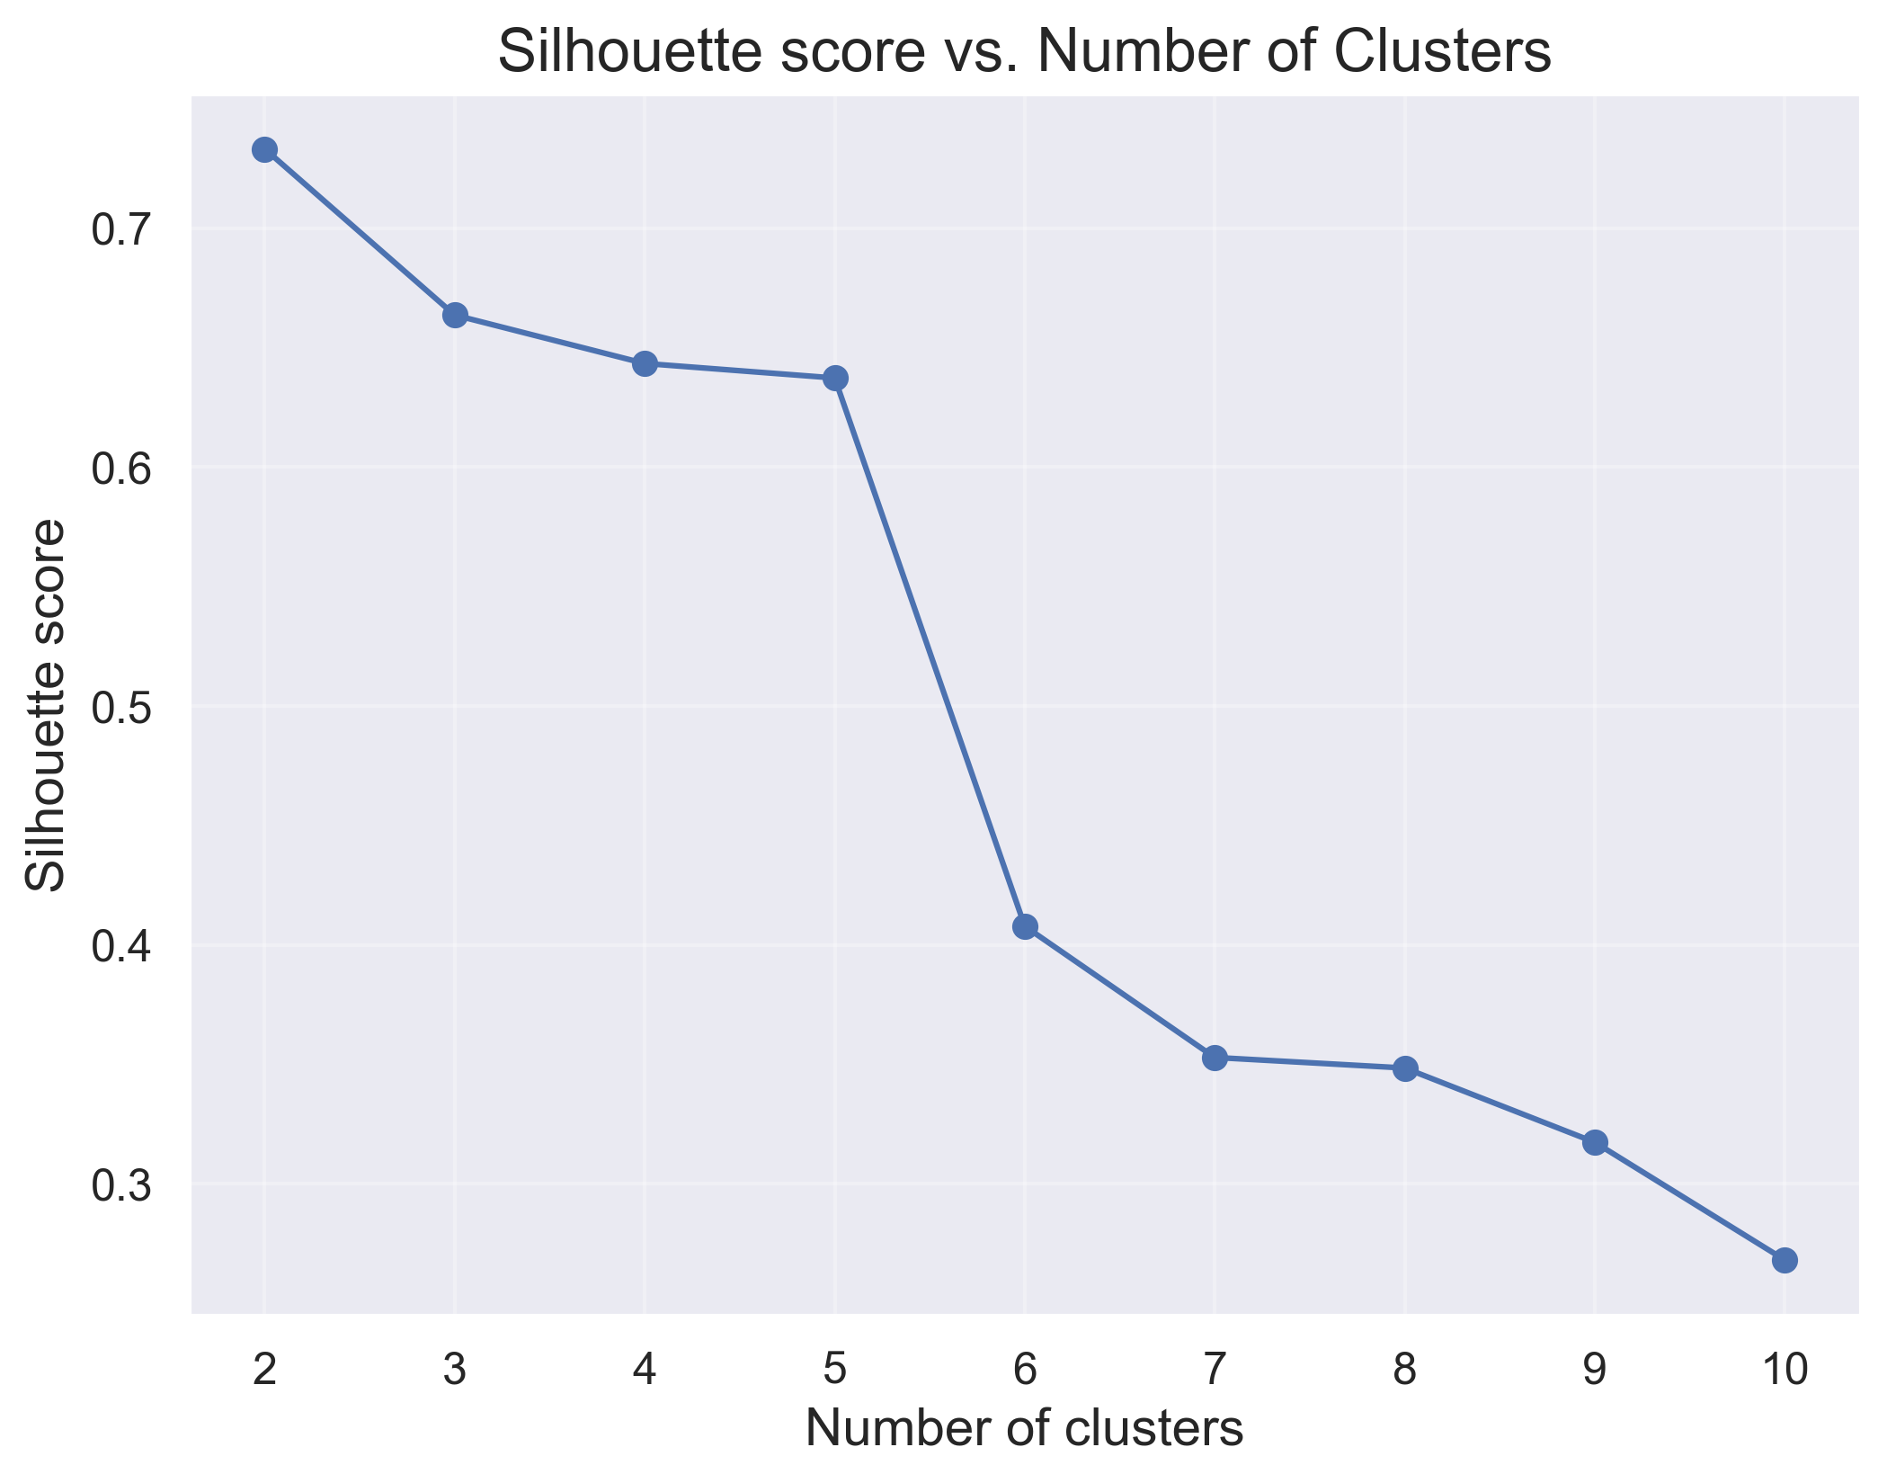
Analyzing Top 20 Countries' Greenhouse Gas Emissions: K-Means Clustering and Exponential Growth Models for India and China
Submitted by: Muhammad Junaid Saif
Supervised by: Ralf Napiwotzki
INTRODUCTION
By using time series analysis, correlation heatmap, clustering, and exponential growth modeling, a comprehensive understanding of the greenhouse gas emission patterns among the top 20 countries was achieved. These techniques revealed trends, relationships, and growth trajectories, contributing to a deeper understanding of global greenhouse gas emissions.
1) TIME SERIES PLOT
The time series plot for the top 20 countries responsible for GHG emissions shows an upward trend for China, with a significant increase across the years. The USA and France also show a rising trend, but it is slower compared to China. The time series for other countries are mostly stationary.
2) CORRELATION MAP
Looking at the values in the matrix, we can see that the correlation coefficients are generally high and positive, indicating a strong positive linear relationship between the variables. For example, the correlation between 1990 and 1996 is 0.98, indicating a very strong positive correlation between these two years. Similarly, the correlation between 2014 and 2019 is 0.998, indicating a very strong positive correlation between these two years.
3) K-MEANS CLUSTERING
To check the optimum no. of clusters, Silhouette score techniques was used, which showed k=2 is best for this k-means clustering
Next, k-means clustering was performed which yielded following clusters.
Trend in GHG emissions in Chine was fitted by exponential curve in order to quantify the rate of growth in emissions. The first output, GHG 1990 0.0033, indicated that the GHG emissions in China in 1990 were approximately 3.33 billion tons. The second output, growth rate 0.050, showed that the GHG emissions in China have been growing at an average annual rate of approximately 5.01%.
For India, the estimated GHG emited is 1.2 trillion metric tons of CO2 equivalent in 1990 and the estimated growth rate is 0.038 per year.
Climate change is one of the most pressing issues facing the world today, and greenhouse gas emissions are a significant contributor to its acceleration. To understand and mitigate this problem, it is important to analyze the greenhouse gas emissions of the top contributors, including India and China.
In this poster presentation, we explore the greenhouse gas emissions of the top 20 countries responsible for this issue, using data from the World Bank. We employed k-means clustering to identify patterns and trends in the data, and then fitted an exponential growth curve to the emissions of India and China. Our analysis provides valuable insights into the dynamics of greenhouse gas emissions, and can help inform policy decisions to mitigate climate change.
RESULTS
BACKGROUND
In recent years, there has been a growing interest in analyzing the GHG emissions of the top contributors to climate change in order to identify patterns, trends, and potential solutions. India and China are among the top emitters of GHGs, and their emissions have been increasing rapidly in recent years. For instance, a recent study by Liu et al. (2020) analyzed the impact of China's emissions on global warming and suggested that reducing China's emissions should be a priority for mitigating global climate change.
According to a report by the Intergovernmental Panel on Climate Change (IPCC), global warming has caused irreversible damage to the planet, and greenhouse gas emissions are a major contributor to this problem (IPCC, 2018). In recent years, there has been growing concern about the impact of greenhouse gas emissions on the environment, and governments around the world are taking steps to reduce their emissions. India and China, as two of the world's largest emitters, play a crucial role in global efforts to mitigate climate change.
The poster presentation explores the greenhouse gas emissions of the top 20 countries responsible for climate change using data from the World Bank. The methodology involves creating time series plots, correlation heatmaps, and applying K-means clustering to identify patterns and trends in the data. The output of the clustering shows that the countries have been divided into two clusters based on their GHG emissions in 1999 and 2019. China, the USA, and the European Union are in one cluster while other countries are in the other cluster. The poster also presents a fit of an exponential growth curve to the GHG emissions data of China and India to quantify the rate of growth in emissions. The analysis provides insights into the dynamics of greenhouse gas emissions, which can help inform policy decisions to mitigate climate change.
CONCLUSION
CONCLUSION
Time Series Plot: Plotted the greenhouse gas emission time series for each of the top 20 countries from 1990 to 2019 to visualize the emission trends over time.
Correlation Heatmap: Created a correlation heatmap to examine the relationships between countries' emissions in specific years (1990, 1996, 2002, 2008, 2014, and 2019) and identify any significant patterns or clusters.
K-Means Clustering: Applied K-means clustering to group the top 20 countries based on similarities in their emission trajectories, providing insights into distinct patterns and similarities among countries.
Exponential Growth Model Fitting: Fitted an exponential growth model to the emission data of China and India to capture the underlying growth patterns. Estimated the parameters to understand the scale factor and growth rate of emissions for these countries.
METHODOLOGY
REFERENCES
Intergovernmental Panel on Climate Change (IPCC). (2018). Global warming of 1.5°C. Retrieved from https://www.ipcc.ch/sr15/
Liu, Y., Ciais, P., Deng, Z., Lei, R., Davis, S. J., Feng, S., ... & Piao, S. (2020). Near-real-time monitoring of global CO2 emissions reveals the effects of the COVID-19 pandemic. Nature Communications, 11(1), 5172.
"Source: World Bank. (2021 total greenhouse gas emissions (kt CO2 equivalent). Retrieved from https://data.worldbank.org/indicator/EN.ATM.GHGT.KT.CE?view=chart

